Slide 1
HOW 2 HOW 2 CODE!!1!1
An improv comedy act
(with brief coding lesson)

Slide 2

Target Audience

Slide 3

The Final Goal

Slide 4
An Overview
Language choice
Online resources
Application of material
Basics
Style guide (yes, that one)

Slide 5
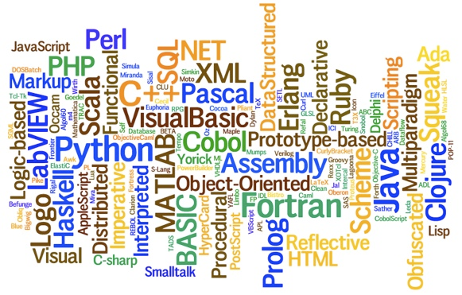
Languages
There are plenty to choose from…
(but don’t worry, none are as bad as English)

Slide 6
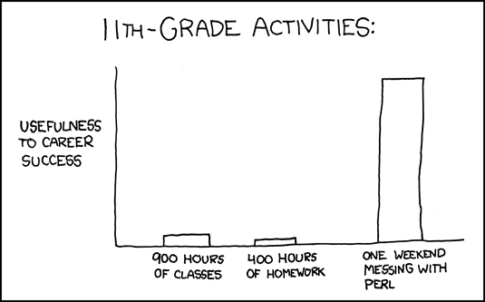
Autodidactism
Self studying FTW

Slide 7
Online Resources
Books are great, but teh interwebz are free!
PAnet =>
Techmasters =>
Web Links =>
Coding Links
Bookmark these pages for later use--even the ones you might find too advanced. They will be useful in the future.

Slide 8
But Books Are Still Great
Amazon
Friends
The OWHL
Online (no, we aren’t advocating piracy)

Slide 9
How to Actually Learn
PROJECTS!!!1!!!!!!1!!
No, really.
That’s the only thing we put on this list.
The cake These points are a lie.

Slide 10
Gangnam Coding Style
Basically, make ur code perty.
Now follows the ultimate way of doing this.
(For those of you not in the know, do not, I repeat, DO NOT do any of these things. Ever.)

